Slide 1


Year One
Phonics Screening Check 2026
A Guide for Parents

Slide 2
Chapters
1
What is Phonics?
2
What is the Phonics Screening Check?
3
What Happens During the Screening?
4
Pseudo Words (Nonsense words)
5
Reporting to Parents
6
How Are the Results Used?
7
How Can I Help My Child at Home?
next page

Slide 3

What is Phonics?
Phonics is a way of teaching children to read quickly and skilfully. Children are taught how to:
recognise the sounds that each individual letter makes;
identify the sounds that different combinations of letters make - such as ‘sh’ or ‘oo’; and blend these sounds together from left to right to make a word. Children can then use this knowledge to ‘de-code’ new words that they see. This is the first important step in learning to read.
chpter
menu
next page

Slide 4

Why Phonics?
Research shows that when phonics is taught in a structured way – starting with the easiest sounds and progressing through to the most complex – it is the most effective way of teaching young children to read. It is particularly helpful for children aged 5 to 7.

Slide 5
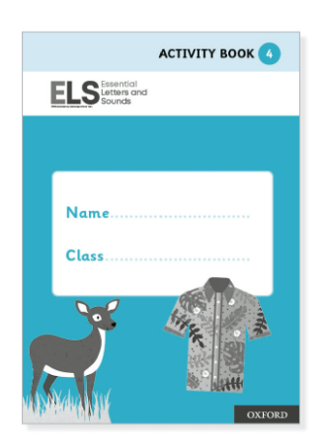
How is phonics taught at Saint Joseph’s Primary School?
Children in Reception and Year 1 have daily phonics lessons.
Children in Rece
Phonics lessons in Year 1 last
approximately 40 minutes.
We use a scheme called ‘Essential Letters and Sounds’.
Some children need extra practice and take part in
phonic intervention groups during the week.
Children take home a phonic phase reading book. These books
contain letter sounds (phonemes) the children have practiced
during their phonics lessons.
and Year 1 have daily phonics lessons.
Phonics lessons in Year 1 phonic last 45 minutes.
Children in Reception and Year 1 have
daily phonics lessons.

Slide 6
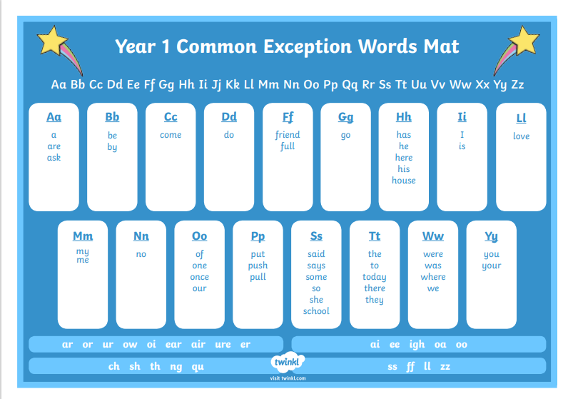
What are
Tricky Words?
“Tricky words” are words that cannot be sounded out using phonics, so children need to learn them by sight.

Slide 7
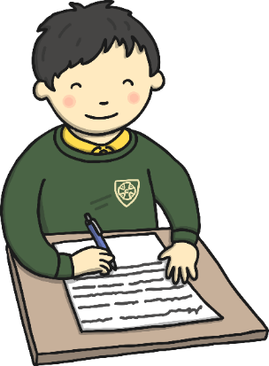
What is the Phonics Screening Check?
Children in Year 1 throughout the country will all be taking part in a
Phonics Screening Check during the same week in June (week beginning 9th June 2025).
Children in Year 2 will also take the check if they did not achieve the required result when in Year 1 or they have not taken the test before.
Headteachers should decide whether it is appropriate for each of their pupils to take the Phonics Screening Check. The phonics screening check is designed to confirm whether individual children have learnt phonic decoding and blending skills to an appropriate standard.
chapter
menu
next page

Slide 8

What Happens During the Test?
The test contains 40 words. Each child will sit one-to-one and read each word aloud to a teacher. The test will take approximately 10 minutes per child, although all children are different and will complete the check at their own pace. The list of words the children read is a combination of 20 real words and 20 pseudo words (nonsense words).
chapter
menu
next page

Slide 9

Pseudo Words (Nonsense Words)
The pseudo words will be shown to your child with a picture of an alien. This provides the children with a context for the pseudo word which is independent from any existing vocabulary they may have. Pseudo words are included because they will be new to all pupils; they do not favour children with a good vocabulary knowledge or visual memory of words.
chapter
menu
next page

Slide 10
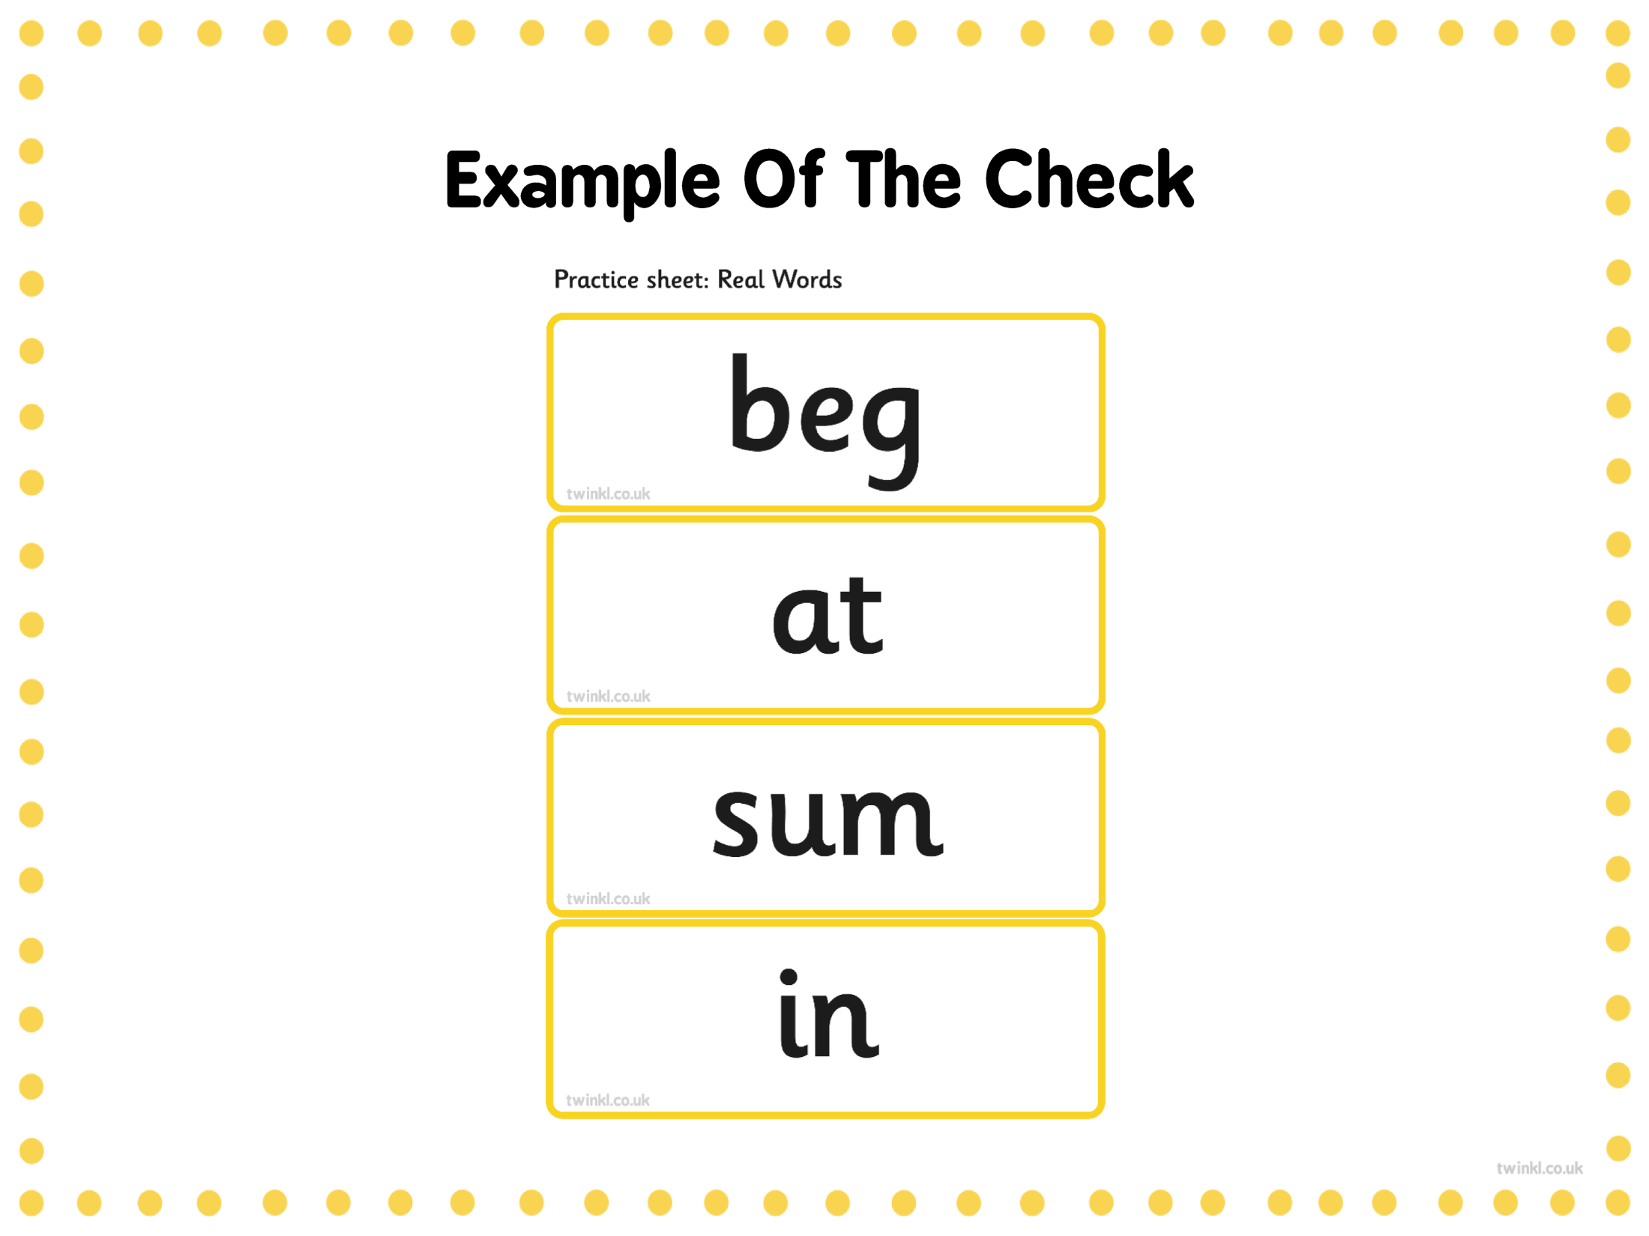

Slide 11
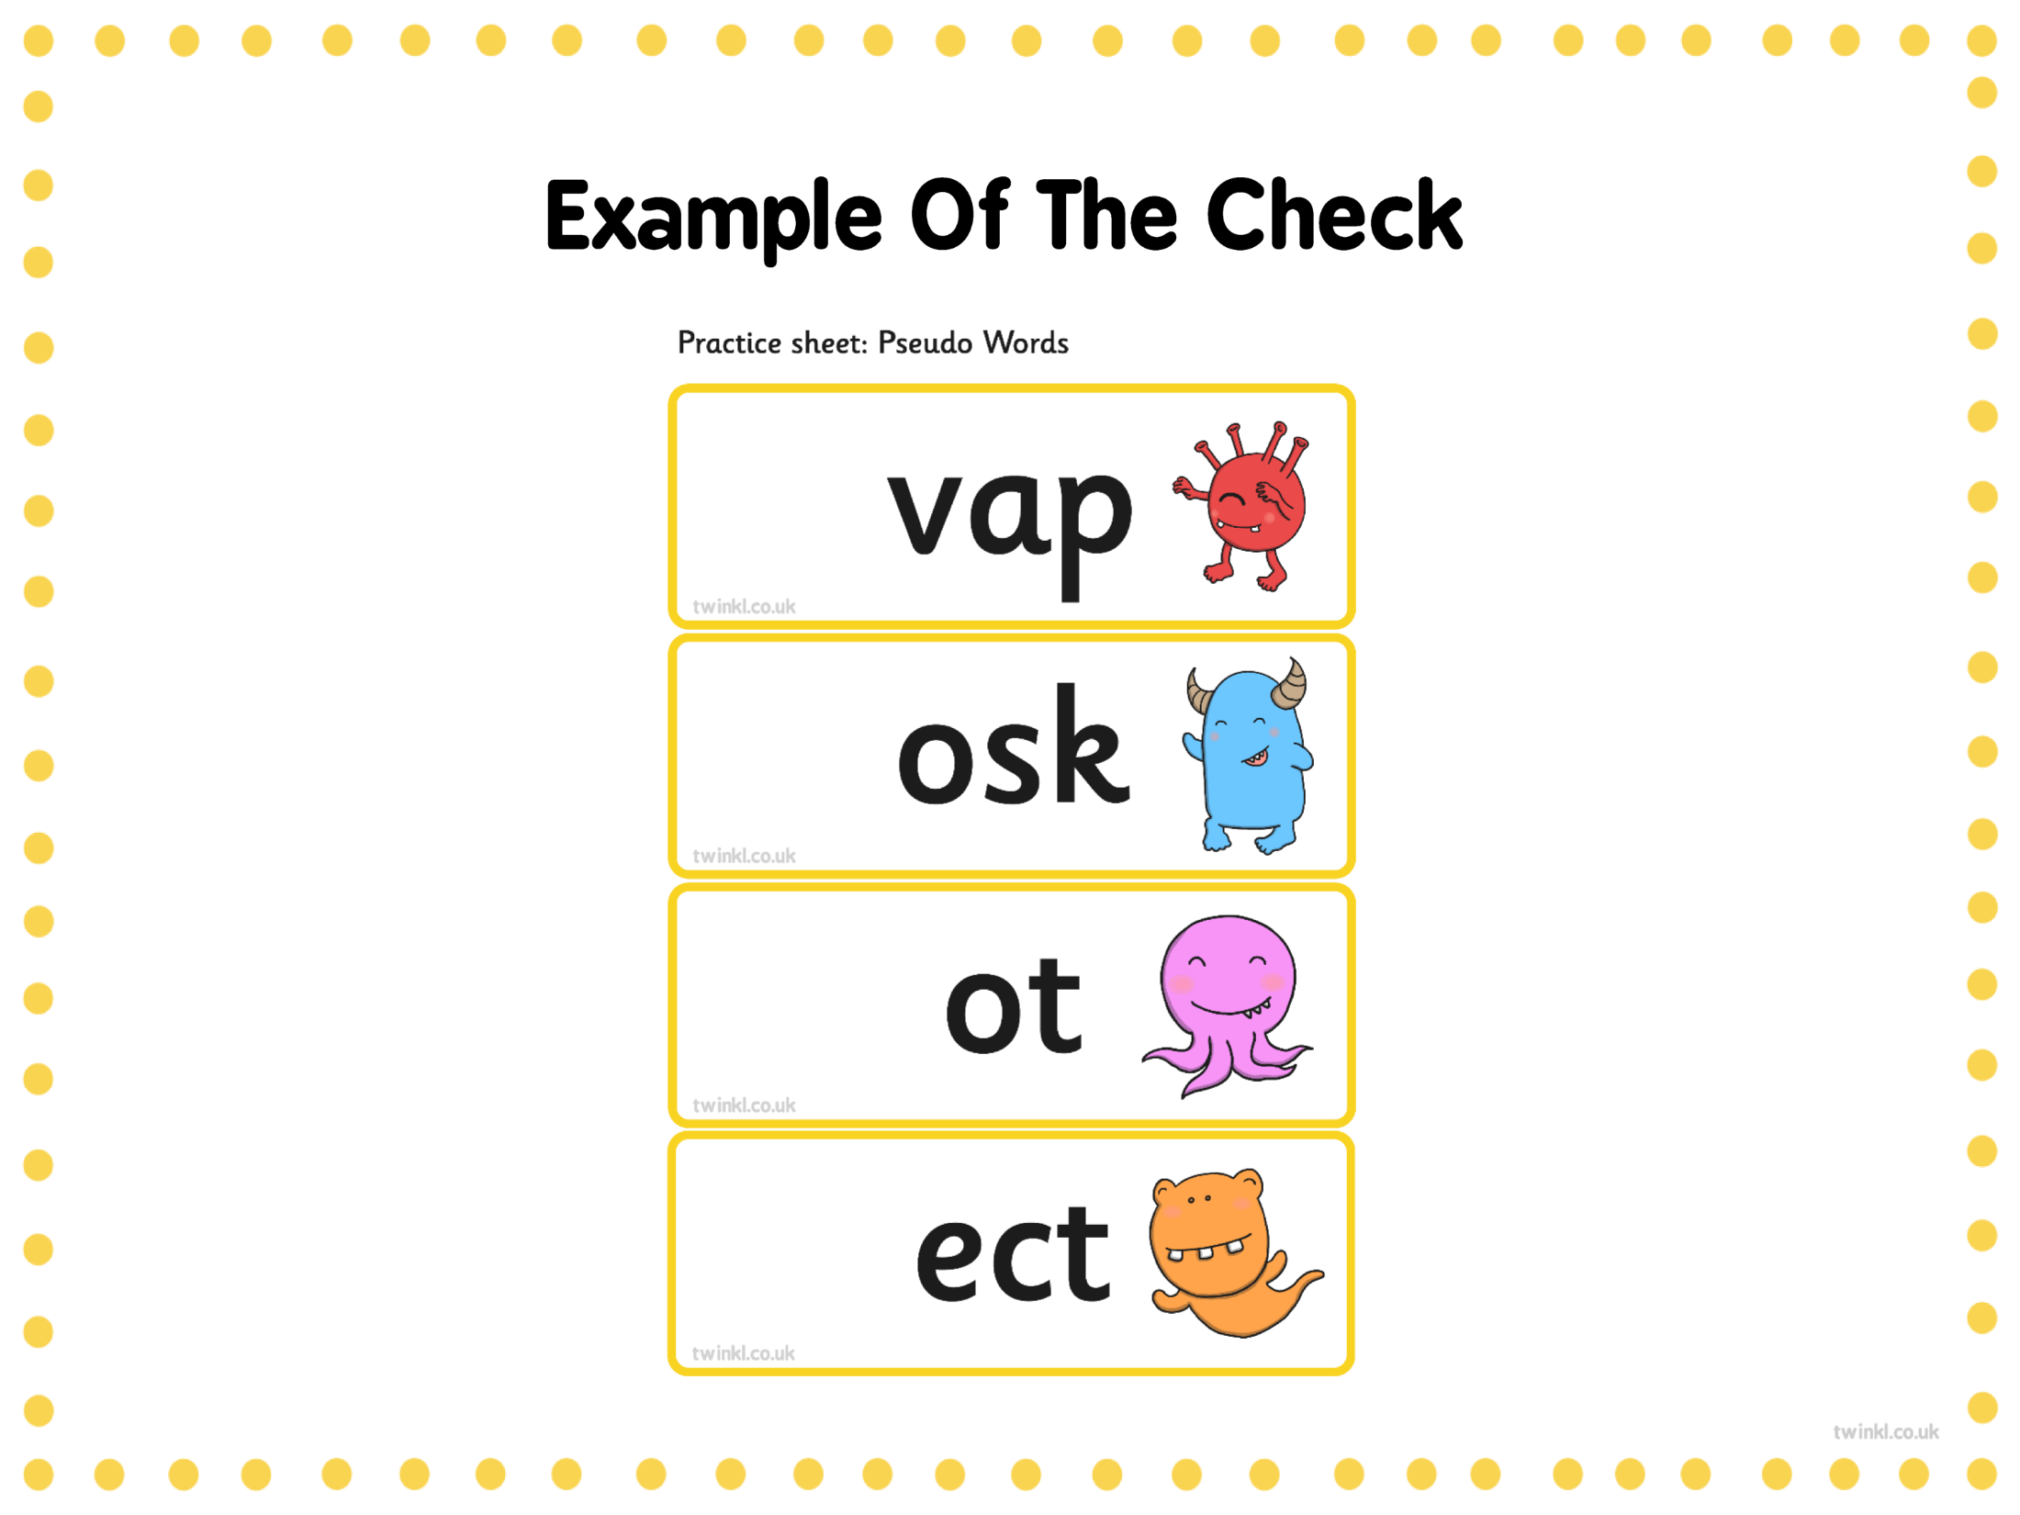

Slide 12

Reporting to Parents
By the end of the summer term all schools must report each child's results to their parents. They will also confirm if the child has met the standard threshold. Children who do not achieve the expected level will retake the test when they are in Year 2.
chapter
menu
next page

Slide 13

How Are the Results Used?
Results from the check will be used by schools to analyse their own performance and for Ofsted to use in inspections.
chapter
menu
next page

Slide 14
How Can I Help My Child at Home?
Play lots of sound and listening games with your child.
Read as much as possible to and with your child.
Encourage and praise their efforts when reading.
If your child is struggling to decode a word, help them by encouraging them to say each sound in the word from left to right.
Blend the sounds by pointing to each one, e.g. /c/ in cat, /p/ in pat, /ng/ in sing, /ee/ in been. Next move your finger under the whole word as you say it.
Discuss the meaning of words if your child does not know what they have read.
chapter
menu
next page

Slide 15
Preparing for the Phonics Screening Check
May half term – phonics activities will be sent home.
Useful websites
PhonicsPlay
ictgames - English: 4-5 year olds
Letters and Sounds, English Games for 5-7 Years – Topmarks
Phonics Games for the Classroom and Home - Phonics Bloom
Phonics screening check: 2023 materials - GOV.UK
PLEASE USE THE FREE RESOURCES – NO SUBSCRIPTIONS NEEDED

